Slide 1
Ice Break Orlando Report2
2017.11.6

Slide 2
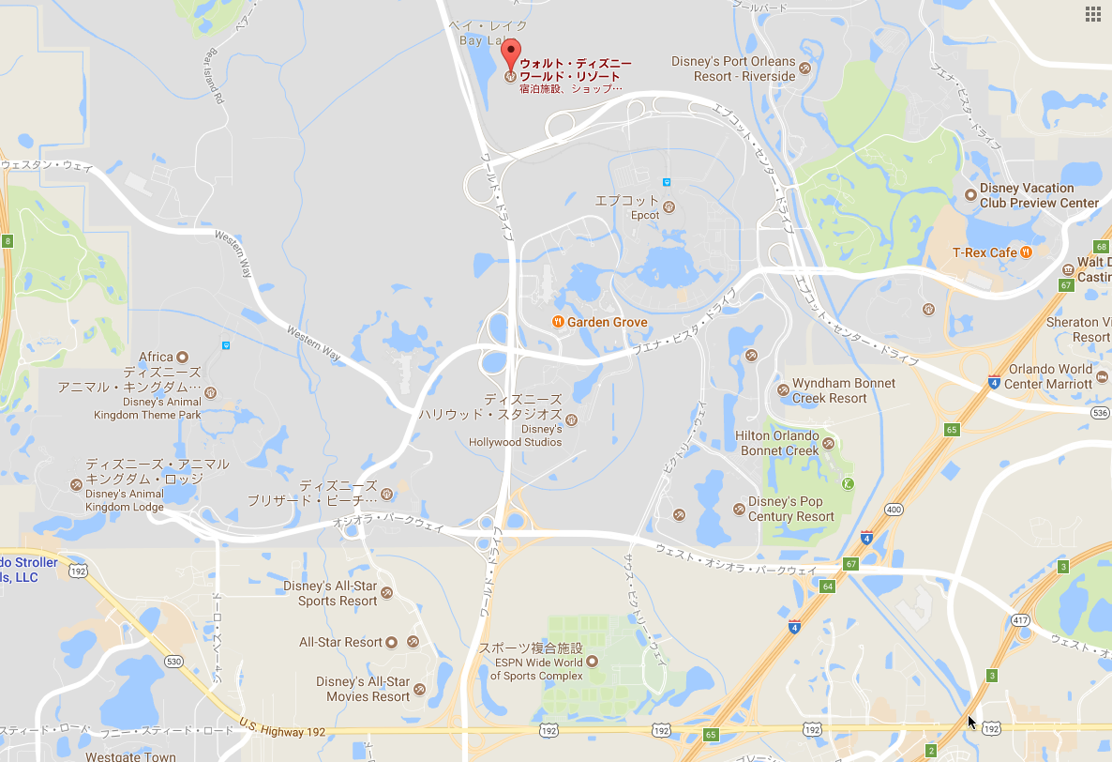
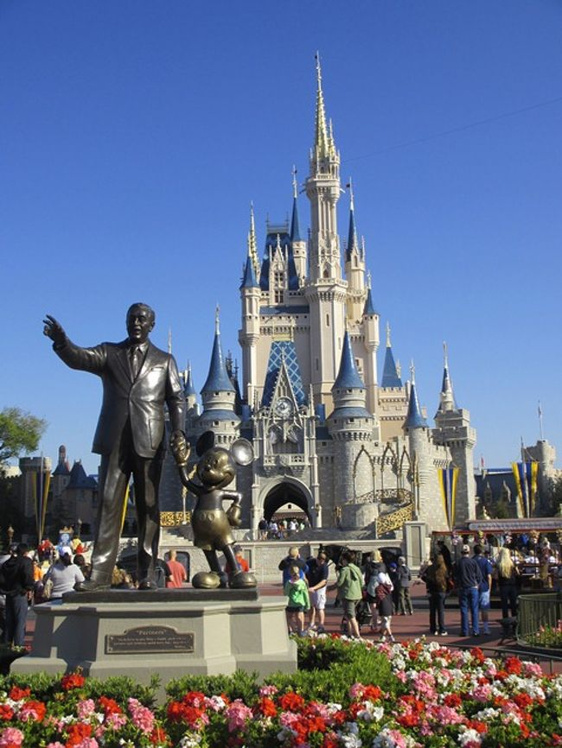
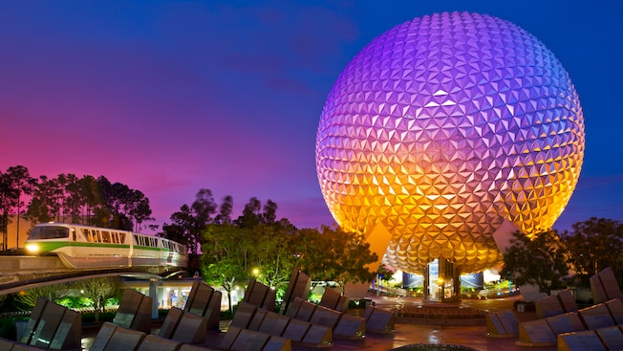
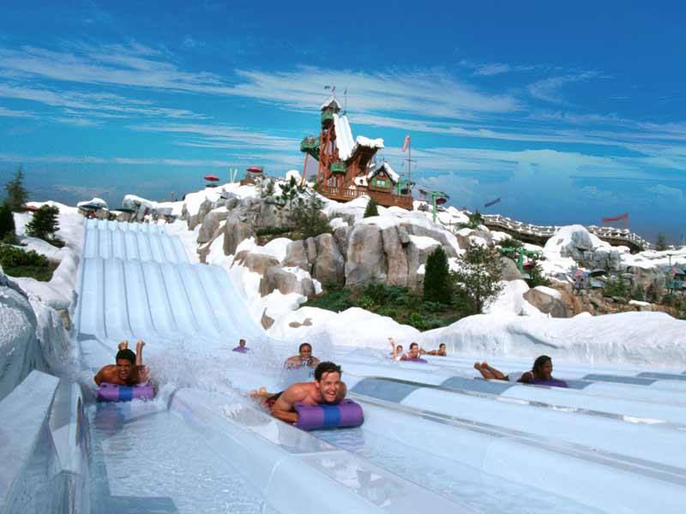
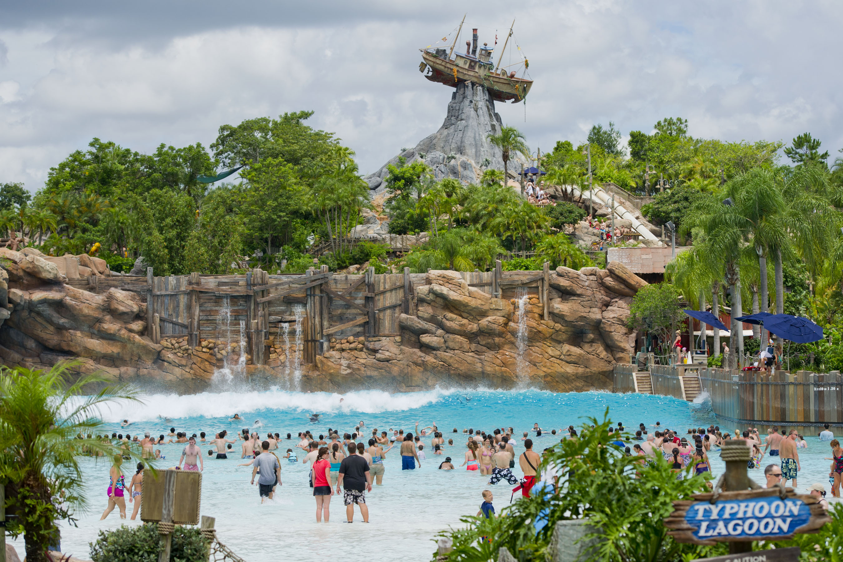
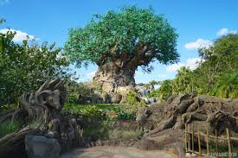
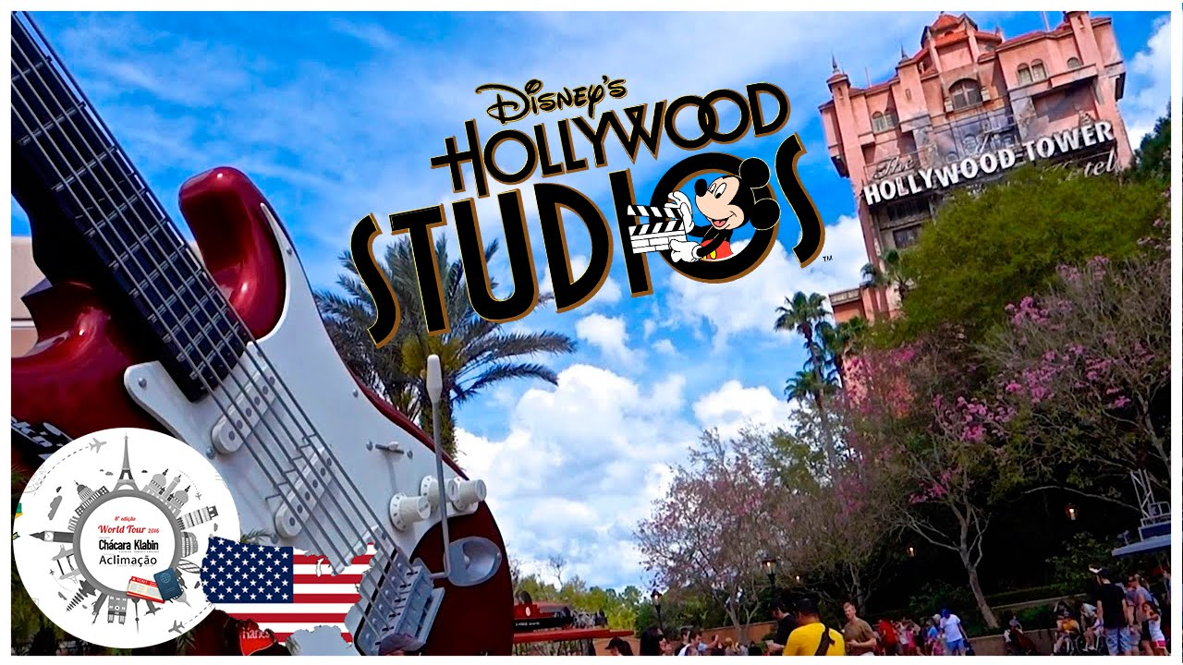
Walt Disney World in Orlando
Magic Kingdom
Epcot
Blizzard Beach
Typhoon Lagoon
Animal Kingdom
Hollywood Studio

Slide 3
My Stay Plan
Day | Action | Remarks
2017.8.31 | Narita -> Washington D.C -> New York -> Orlando | It took 30 hours because of hurricane Harvey.
2017.9.1 | Epcot
2017.9.2 | Animal Kingdom
2017.9.3 | Epcot | My wife’s working day
2017.9.4 | Magic Kingdom
2017.9.5 | Hollywood Studios
2017.9.6 | Typhoon Lagoon
2017.9.7 | Universal Orlando Volcano Bay | Water park of Universal
2017.9.8 | Kennedy Space Center | My wife’s working day
2017.9.9 | Cirque Du Soleil at Disney springs | My wife’s working day
2017.9.10 | Hotel Stay | Hurricane Irma had come.
2017.9.11 | Hotel Stay | Hurricane Irma had come.
2017.9.12 | Epcot | My wife’s working day
2017.9.13 | Orlando -> Huston -> Narita

Slide 4
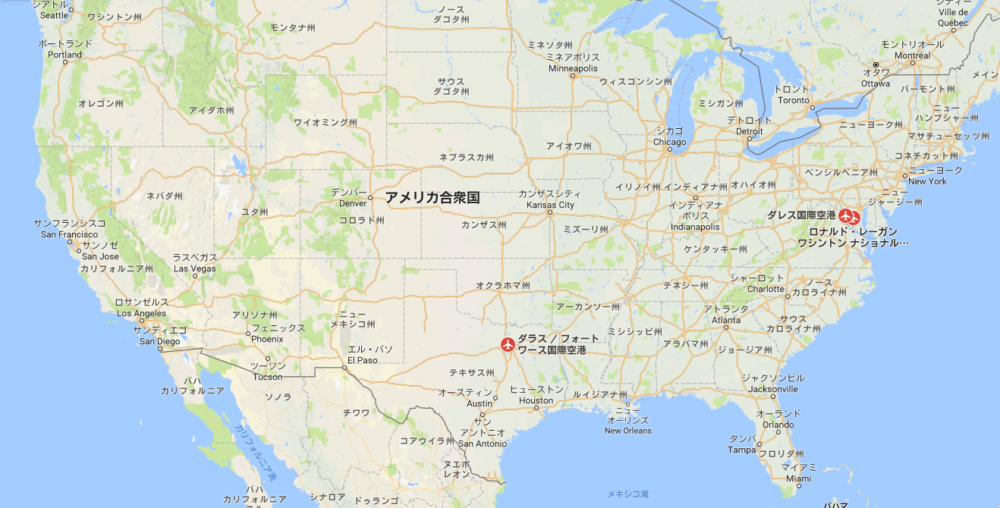
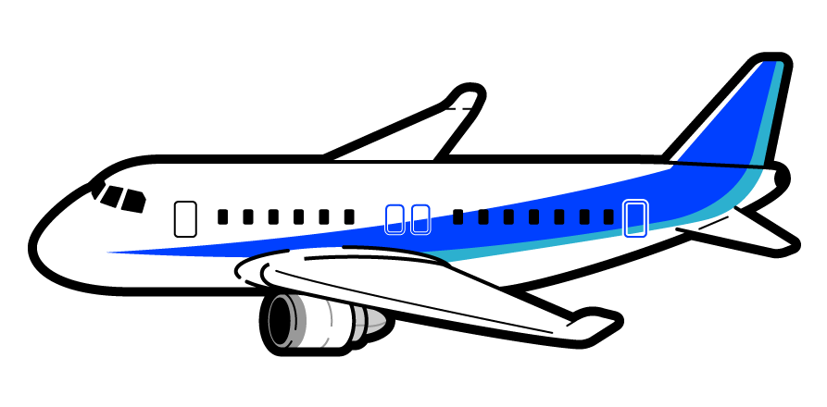
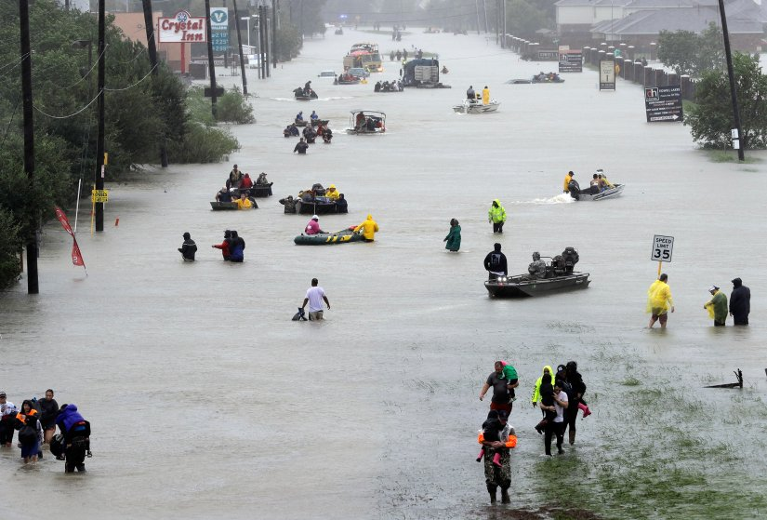
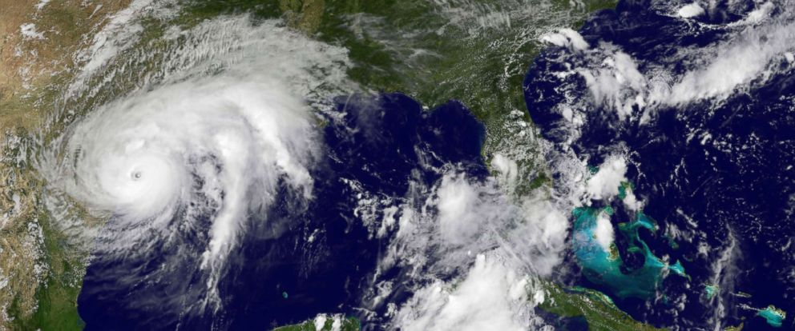
Day1 : To Orlando
Planned Flight
Changed Flight
Hurricane Harvey had come.

Slide 5
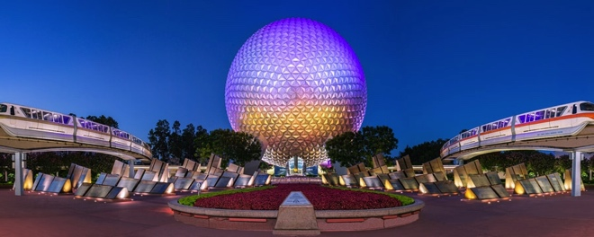
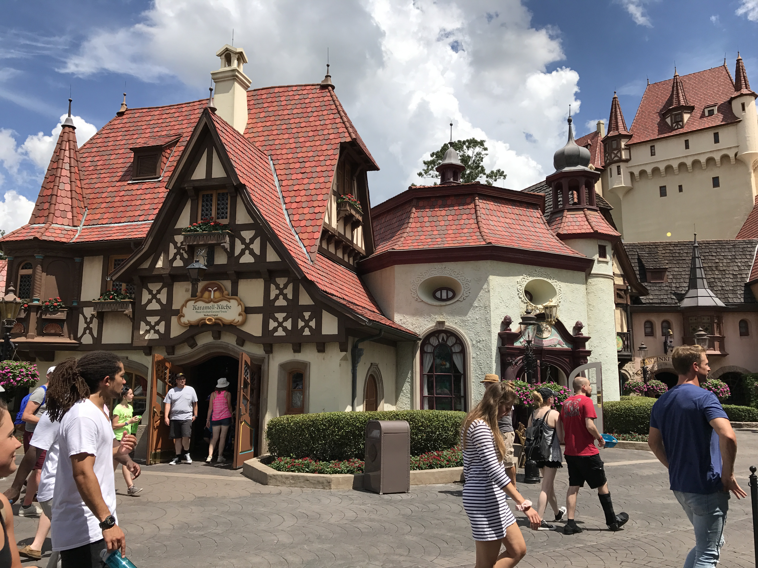
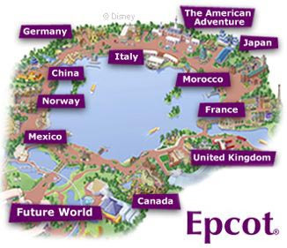
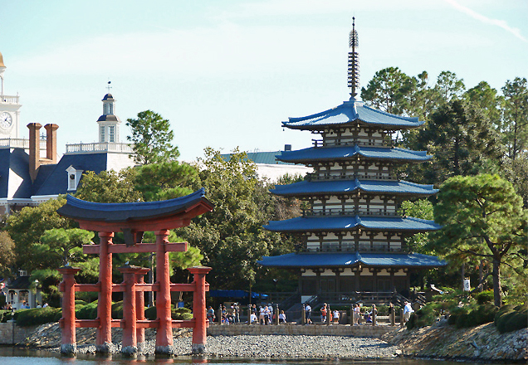
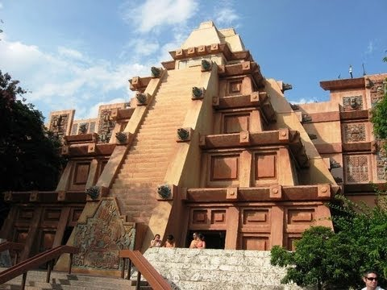
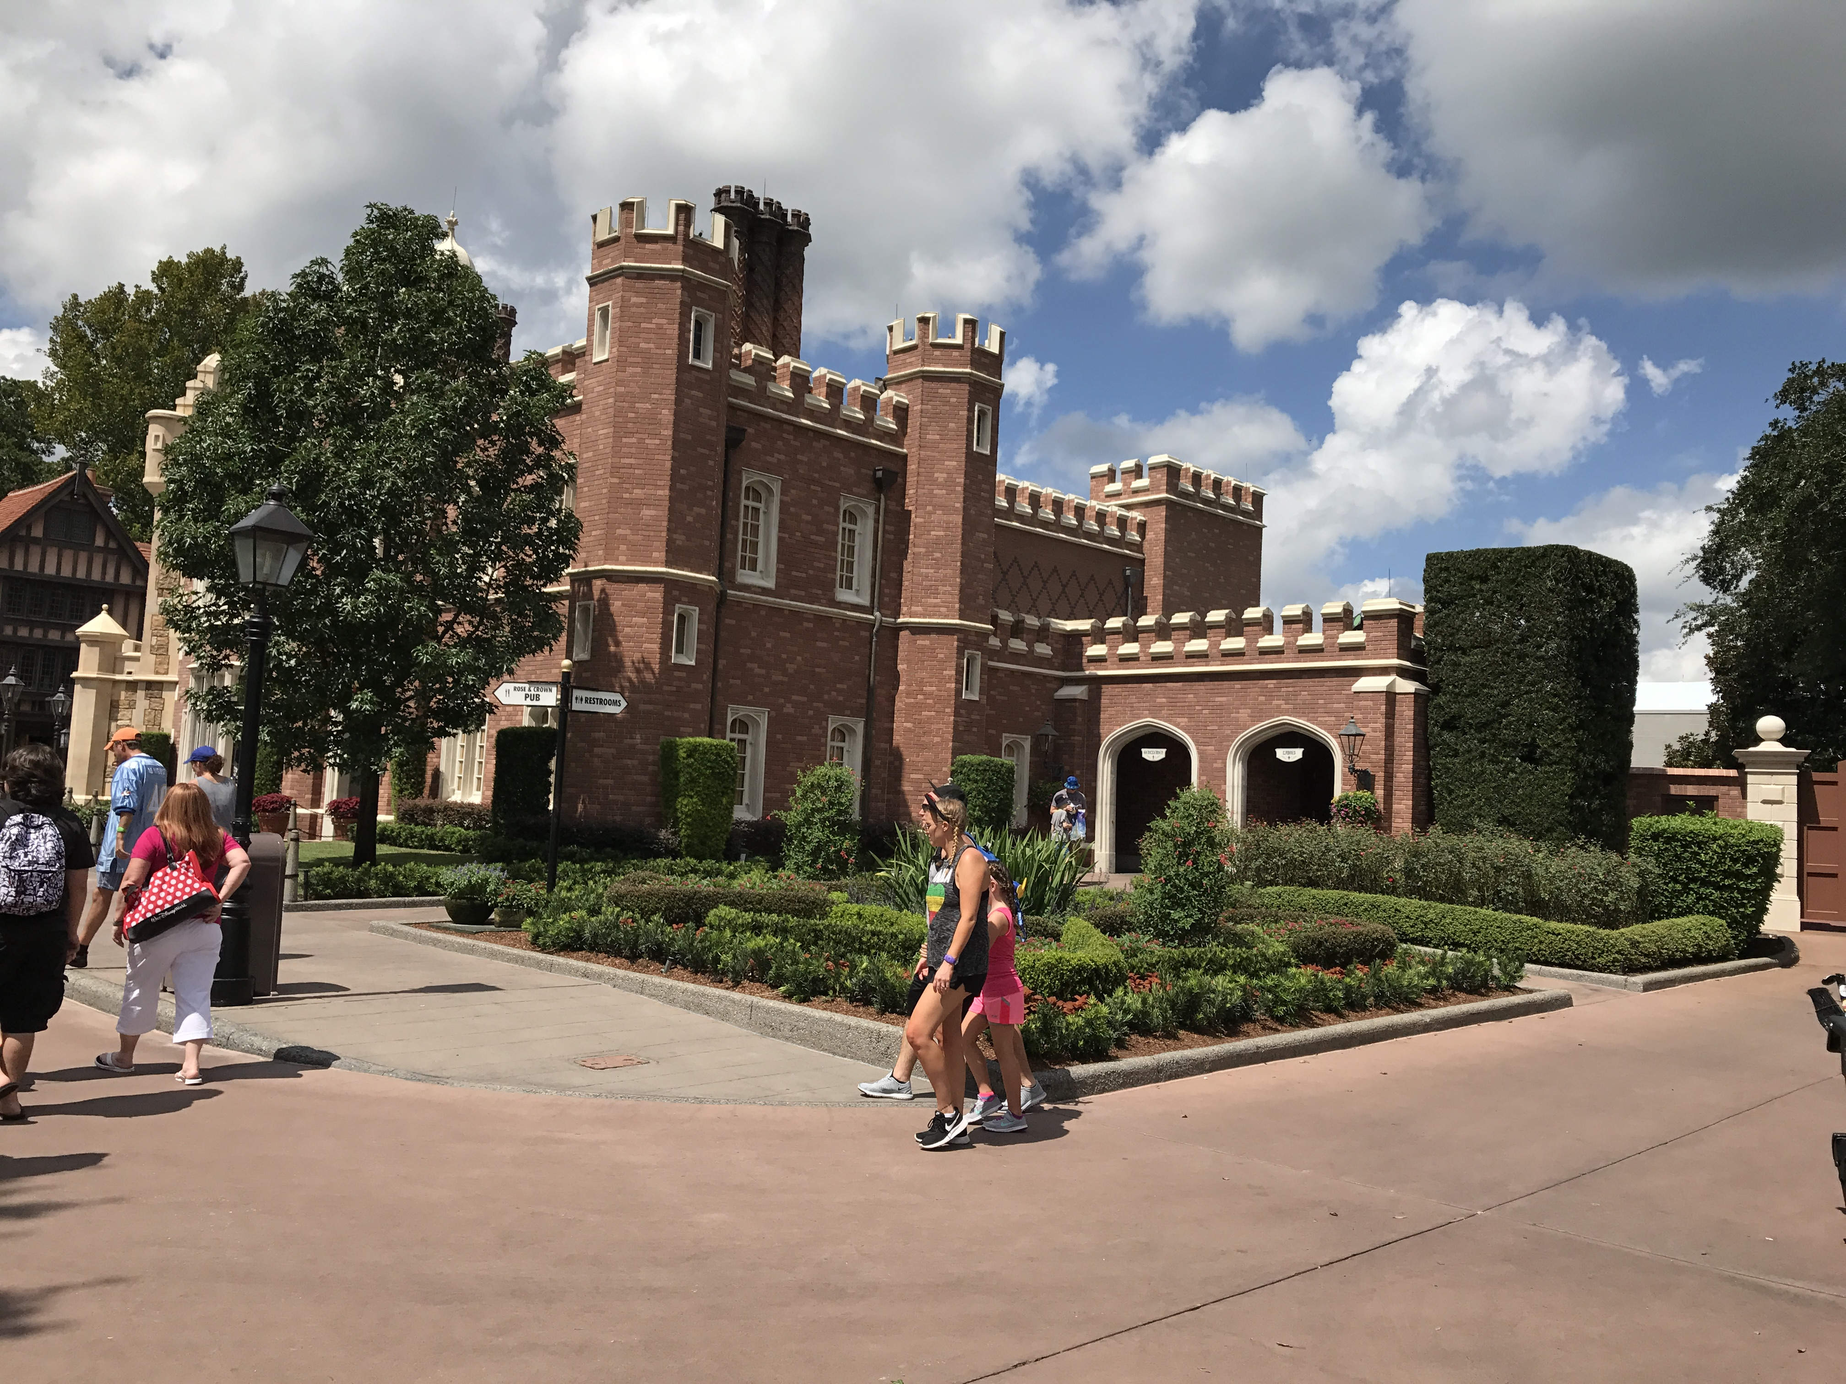
Day2, 4, 12 : Epcot (Experimental Prototype Community Of Tomorrow)
World showcase

Slide 6
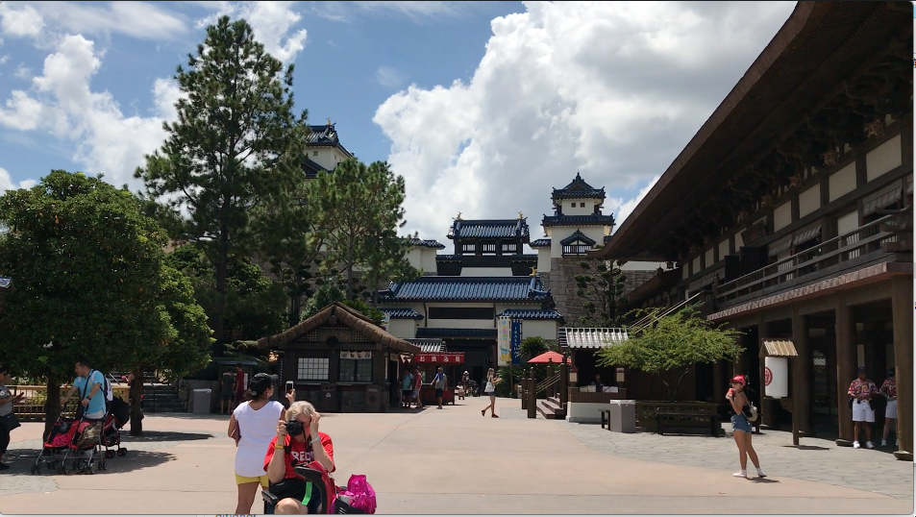
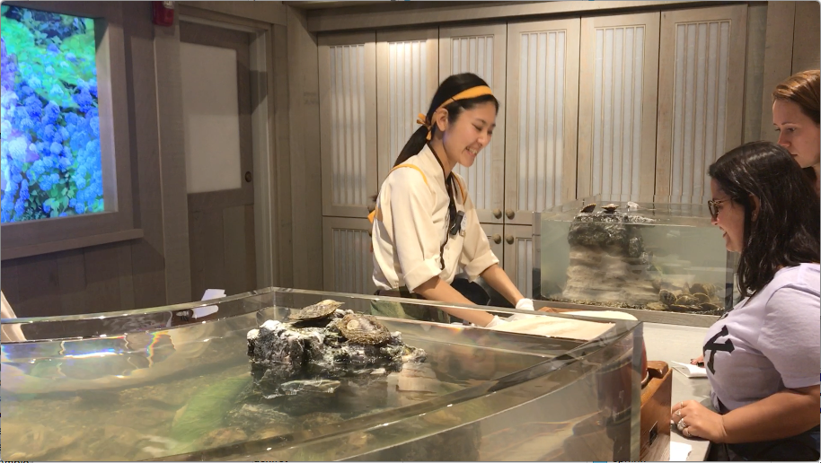
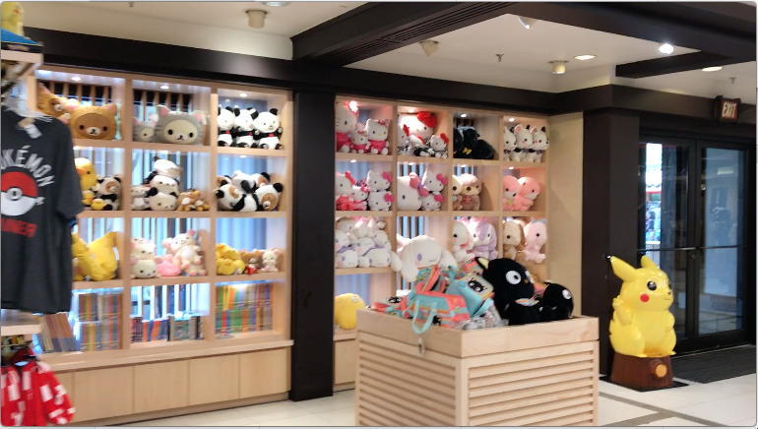
Day2, 4, 12 : Epcot - Japan pavilion
Japanese stuff shop
Pick a pearl

Slide 7
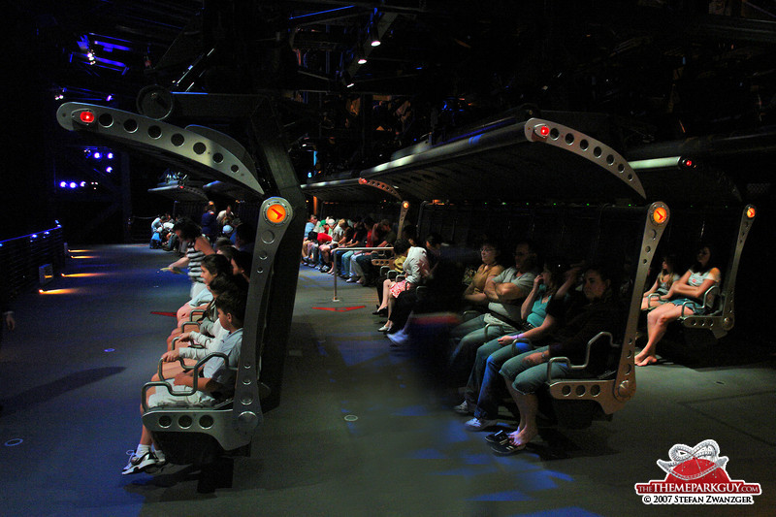
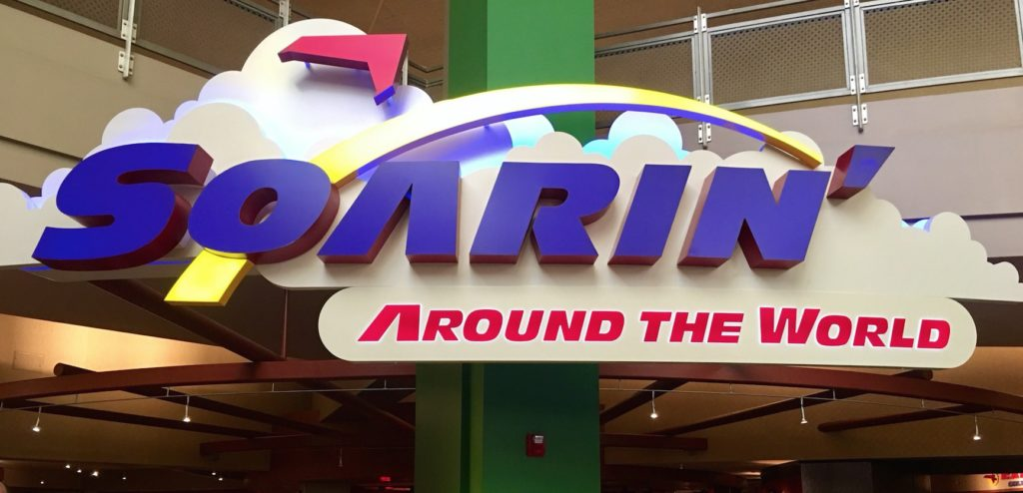
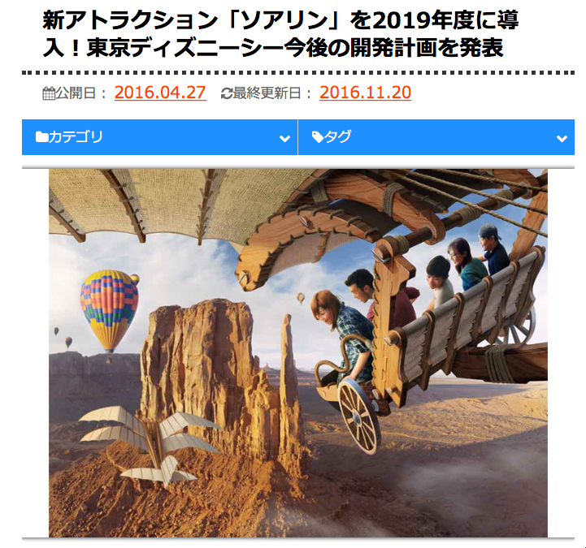
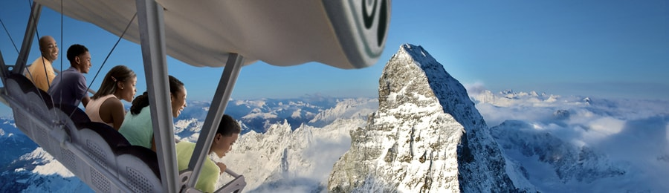
Day2, 4, 12 : Epcot – Attraction My most favorite attraction in Epcot

Slide 8
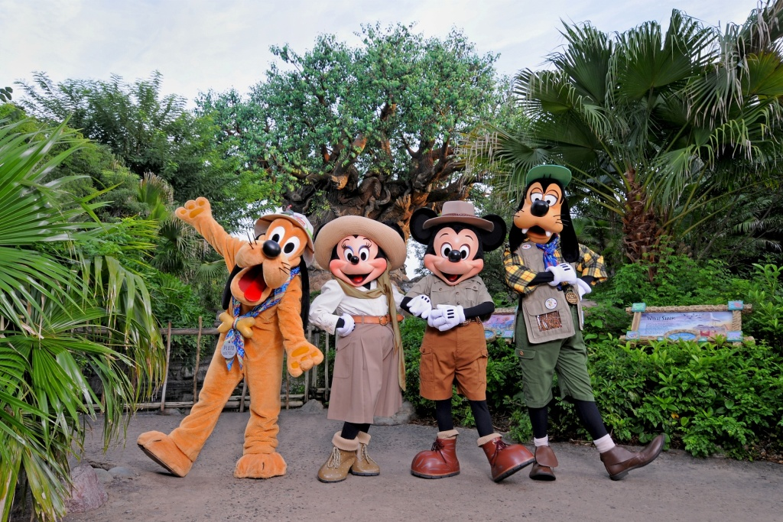
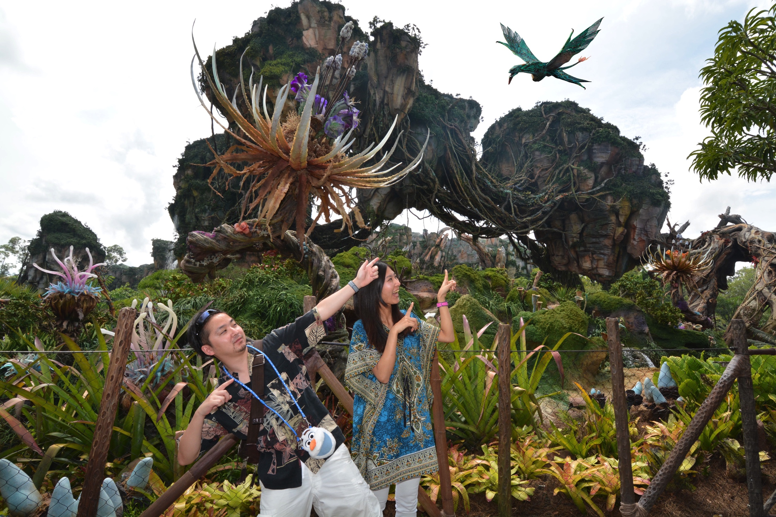
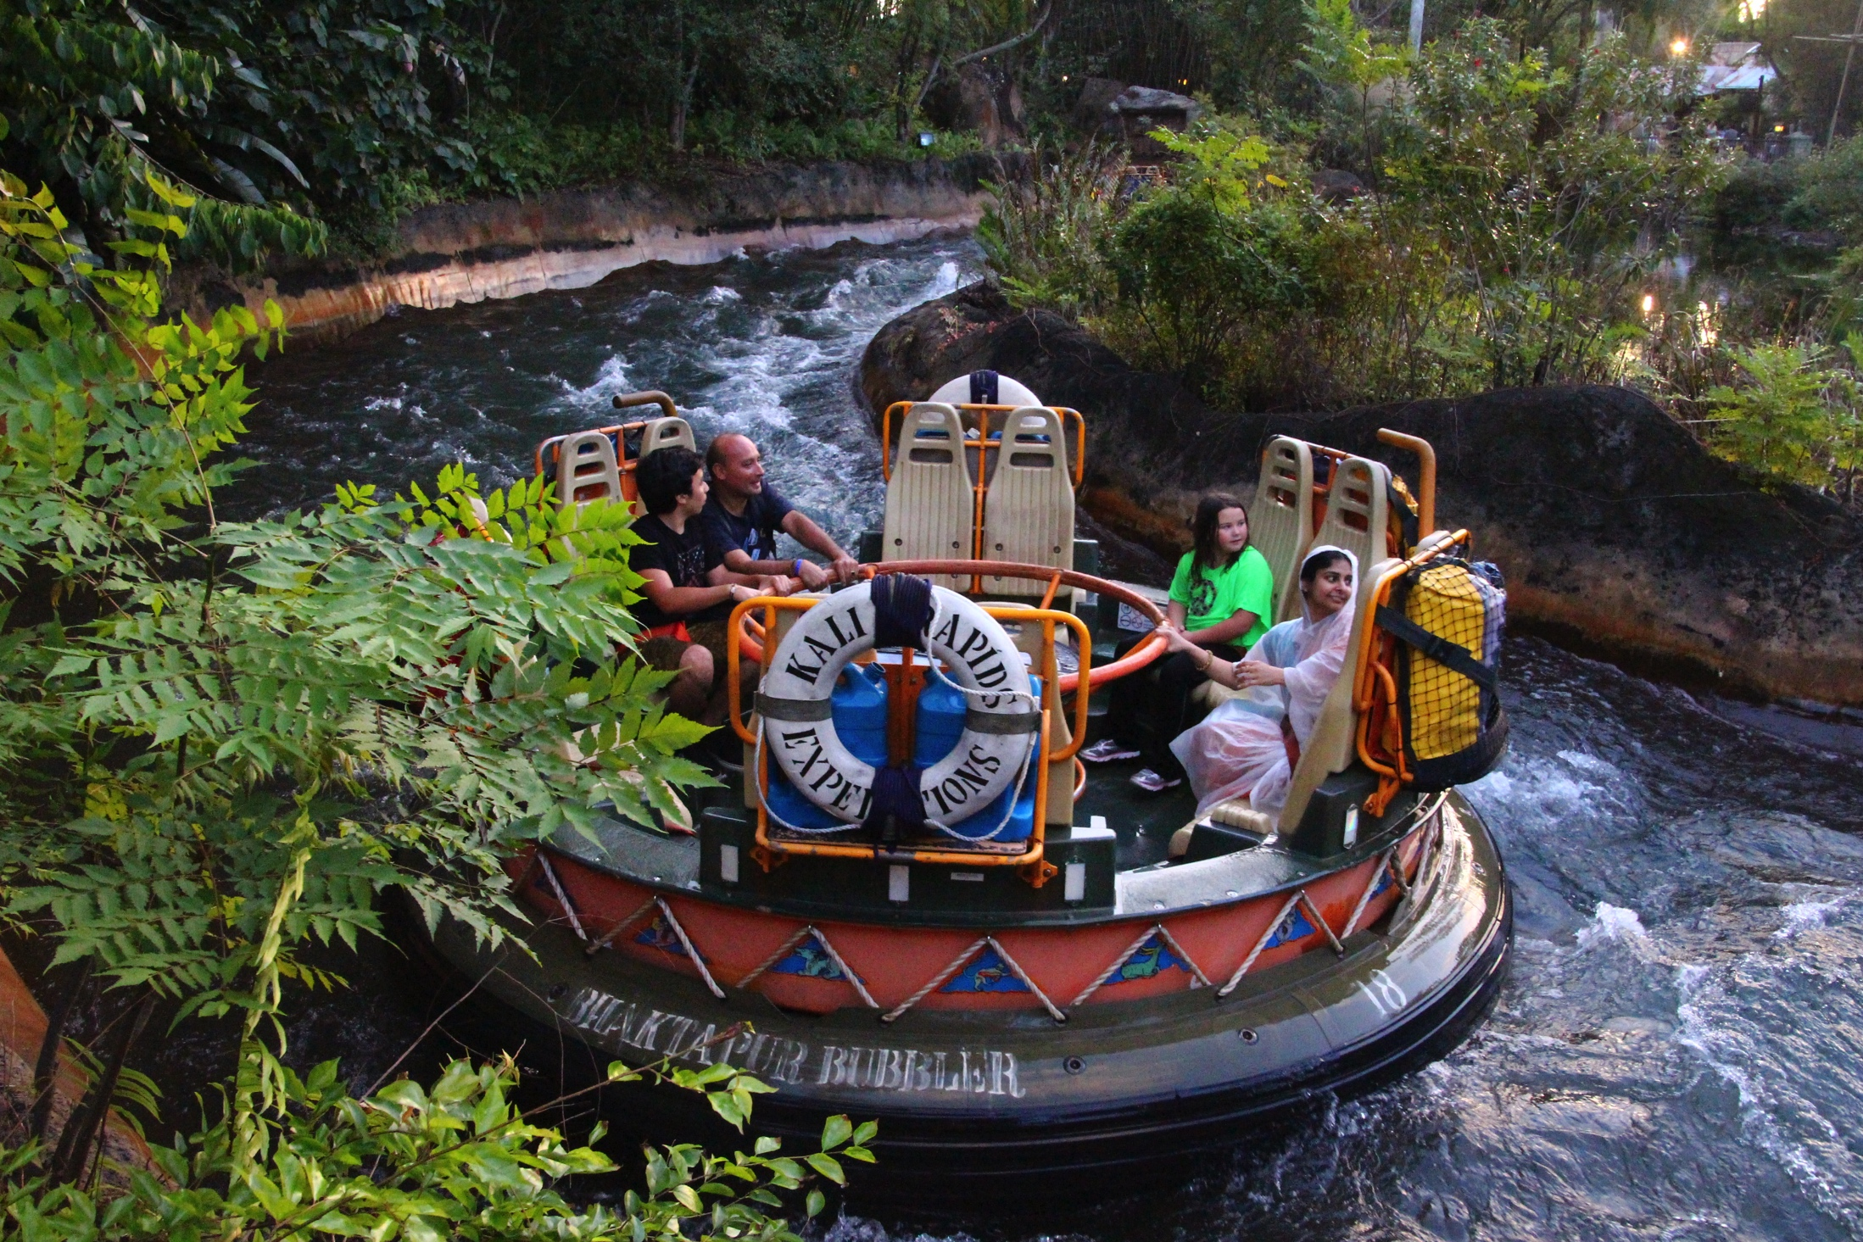
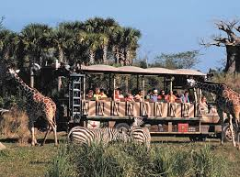
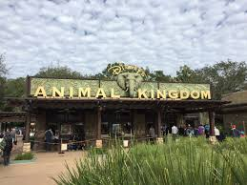
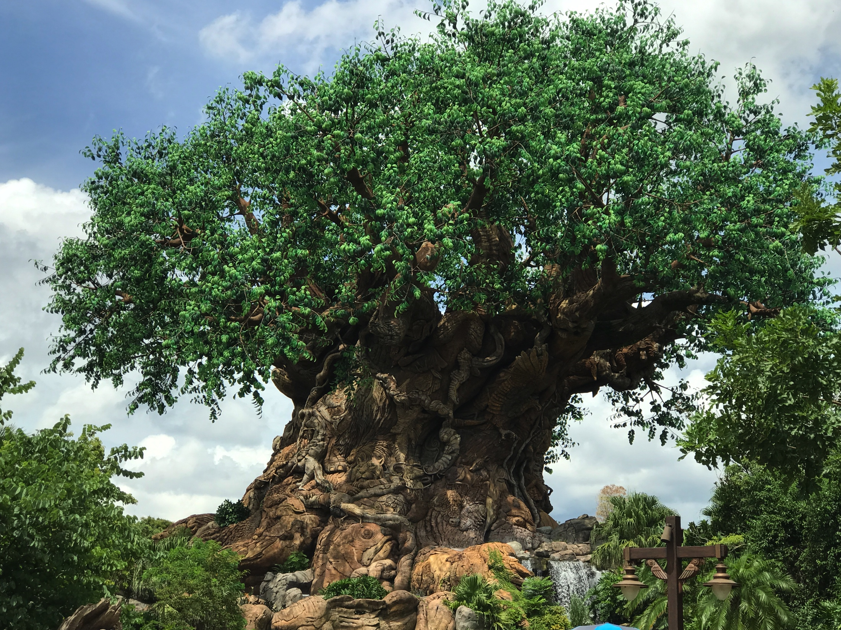
Day3 : Animal Kingdom

Slide 9
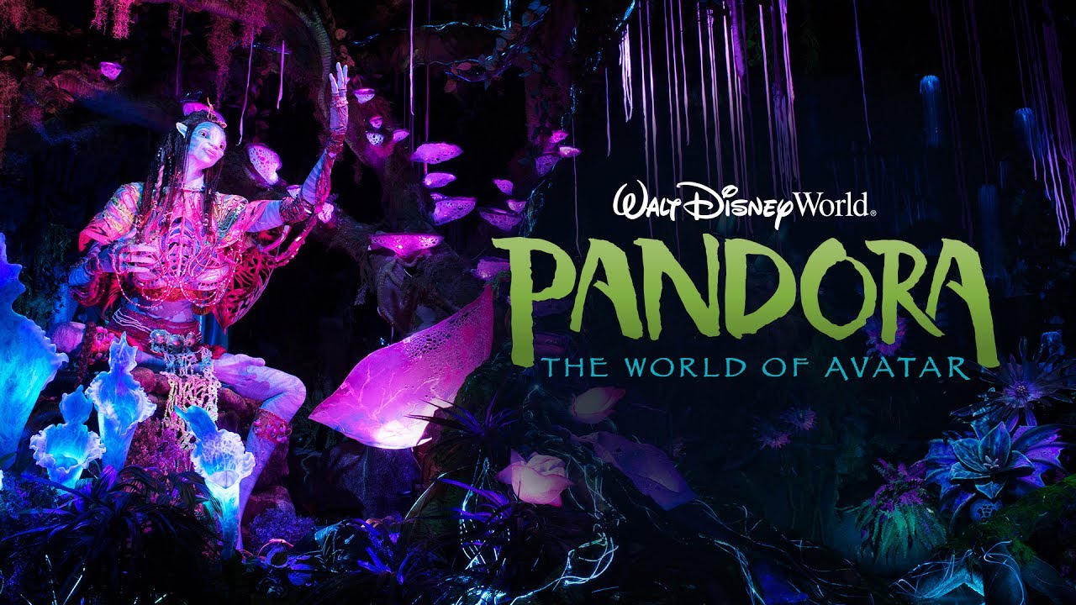
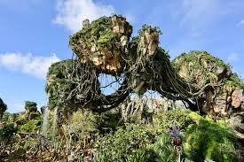
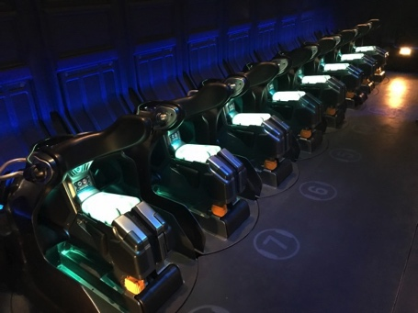
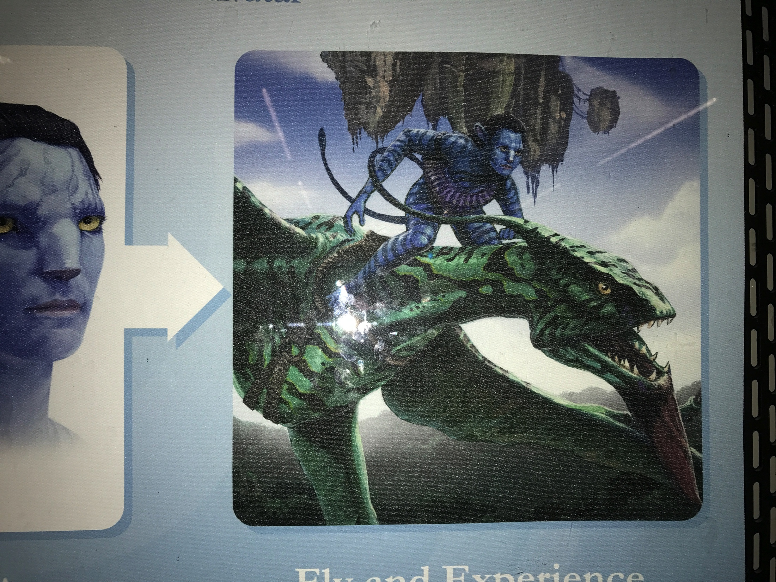
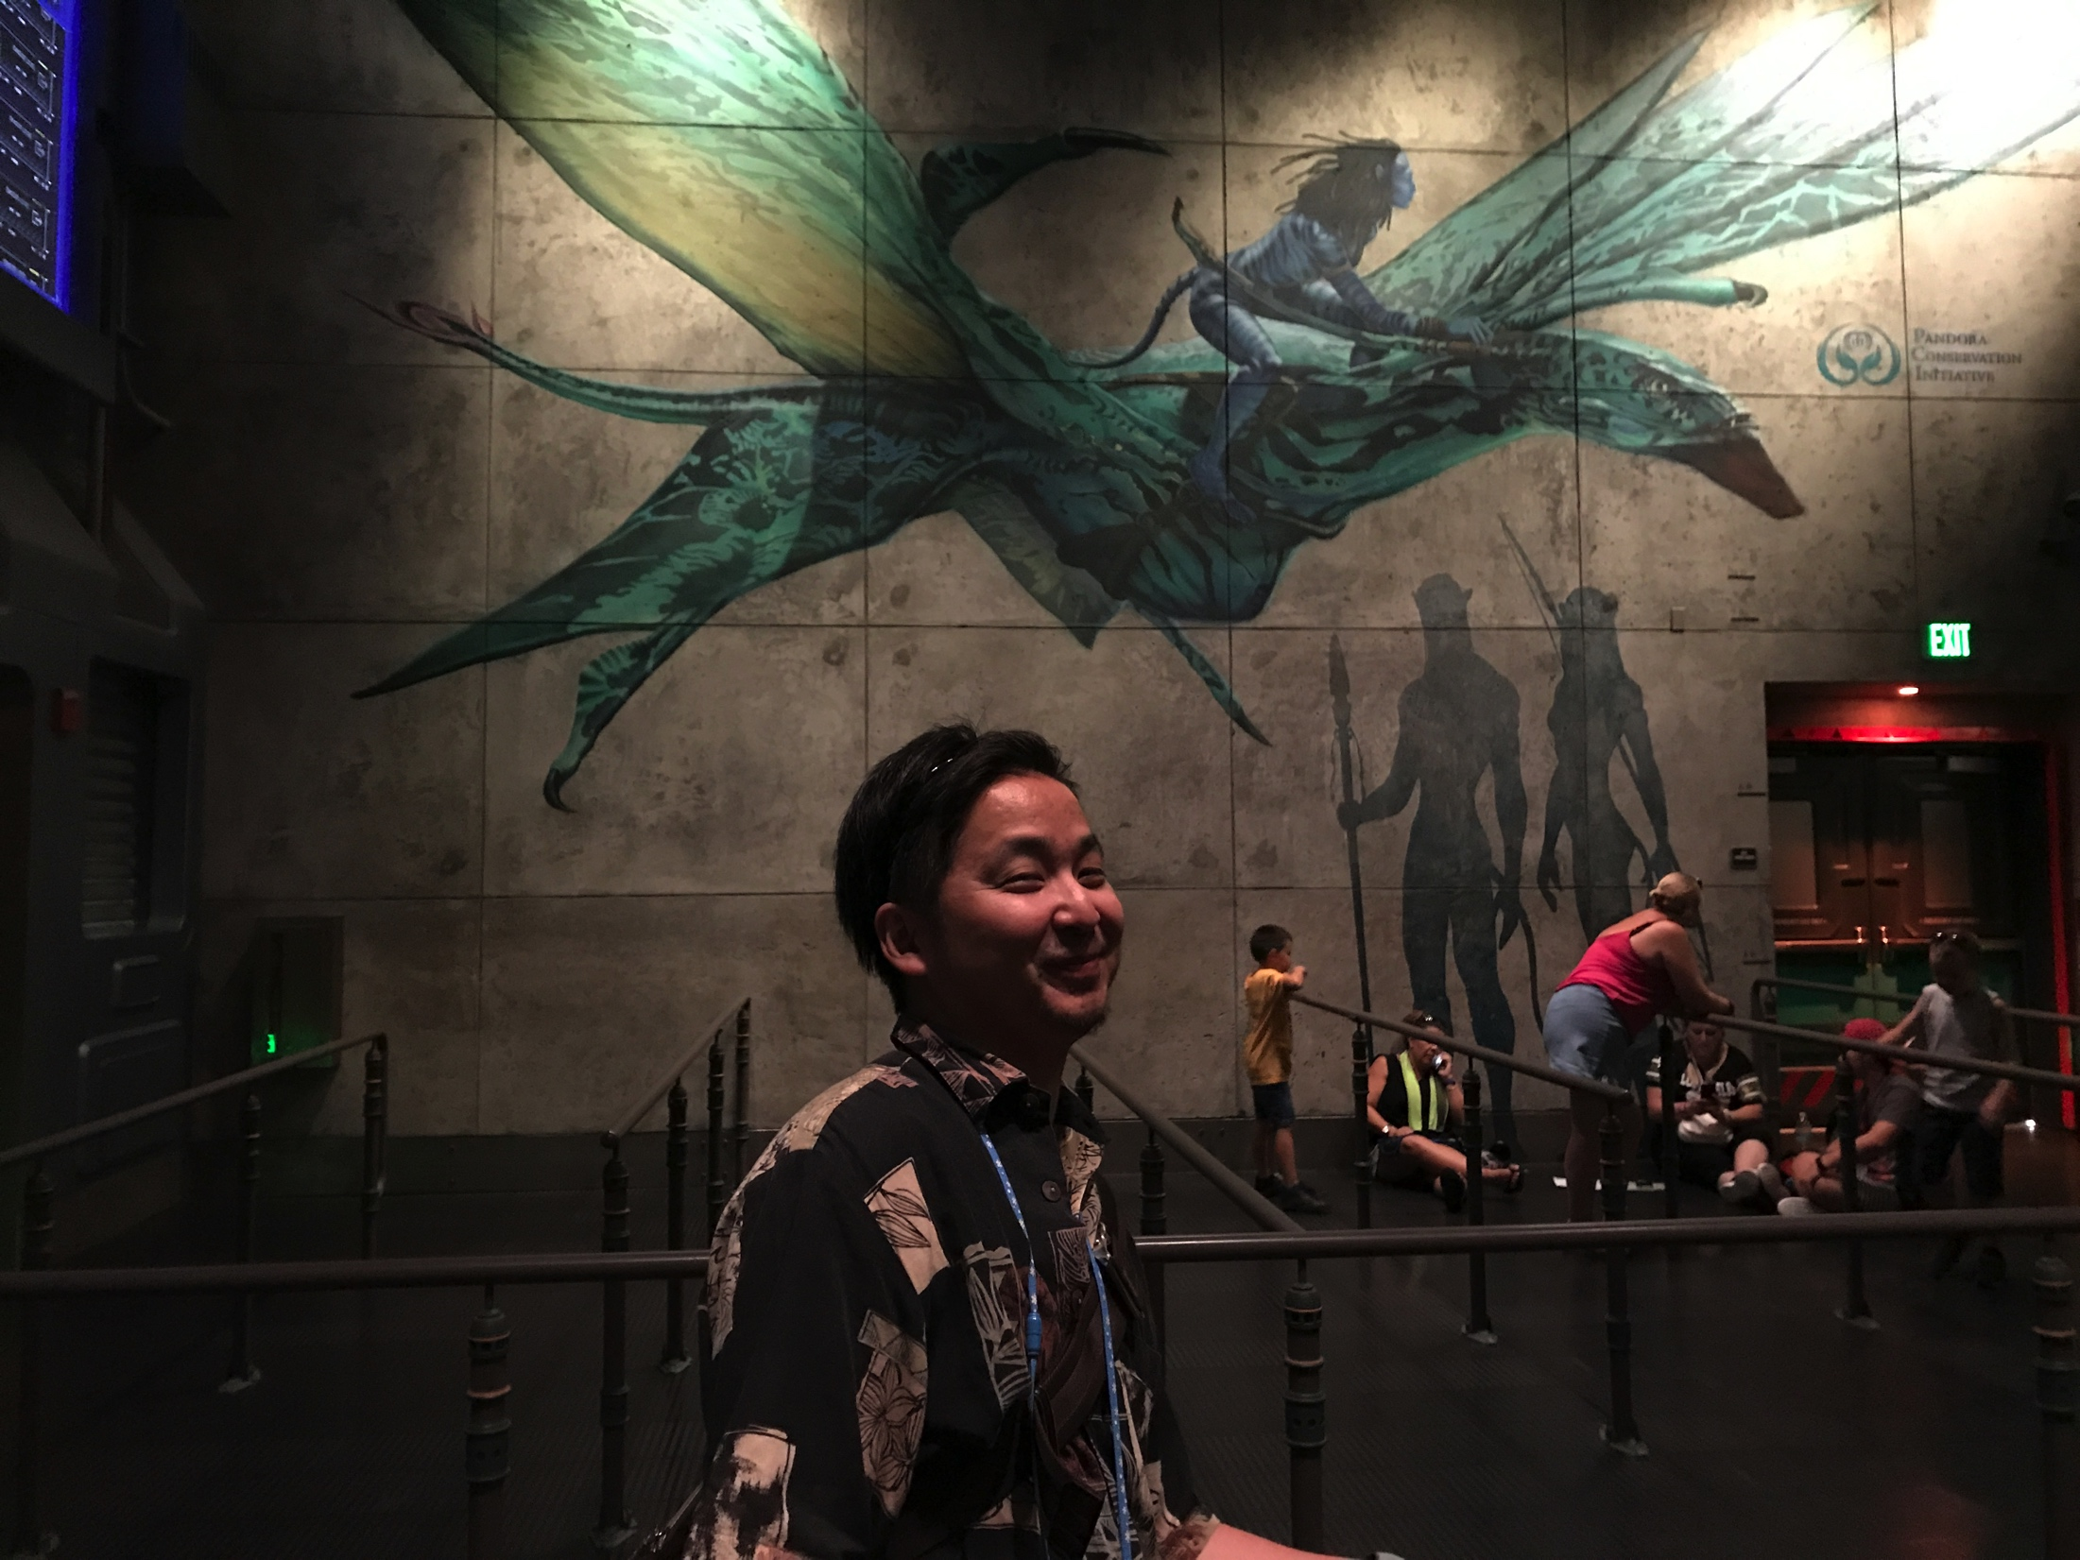
Day3 : Animal Kingdom Attraction
My most favorite attraction in Animal Kingdom
https://www.youtube.com/watch?v=WMxeDMPvSnI

Slide 10
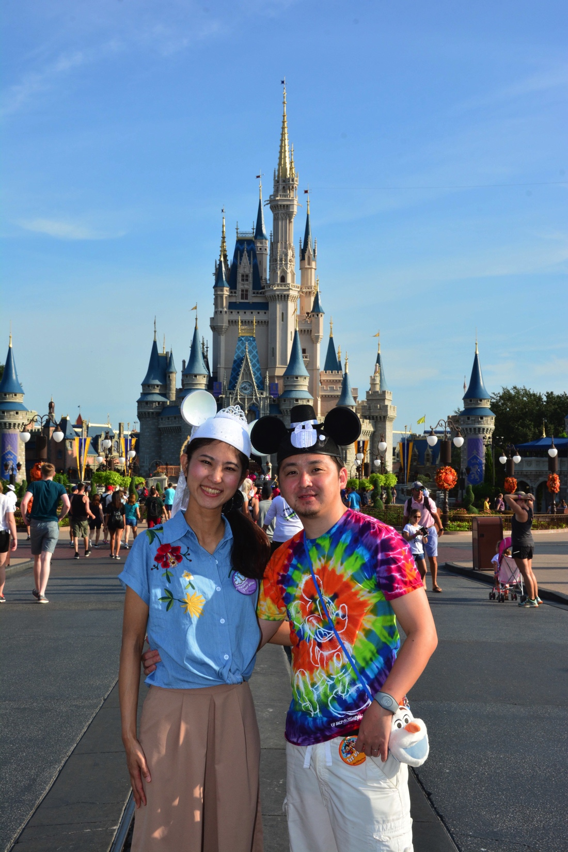
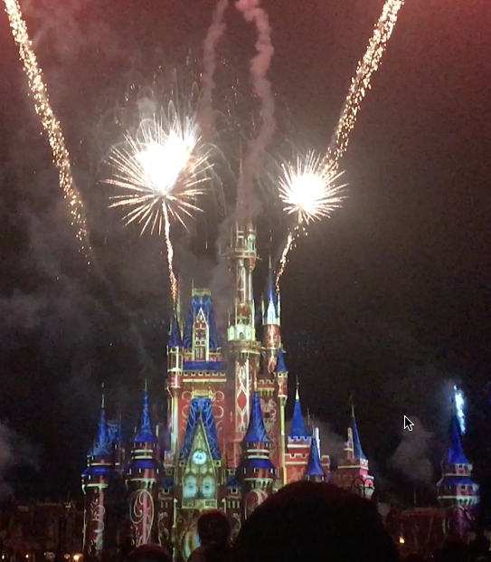
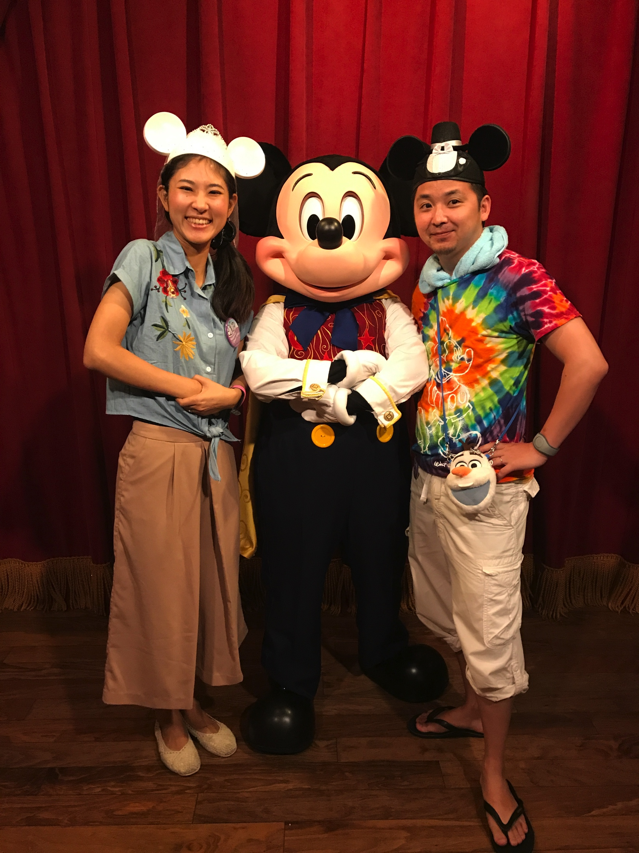
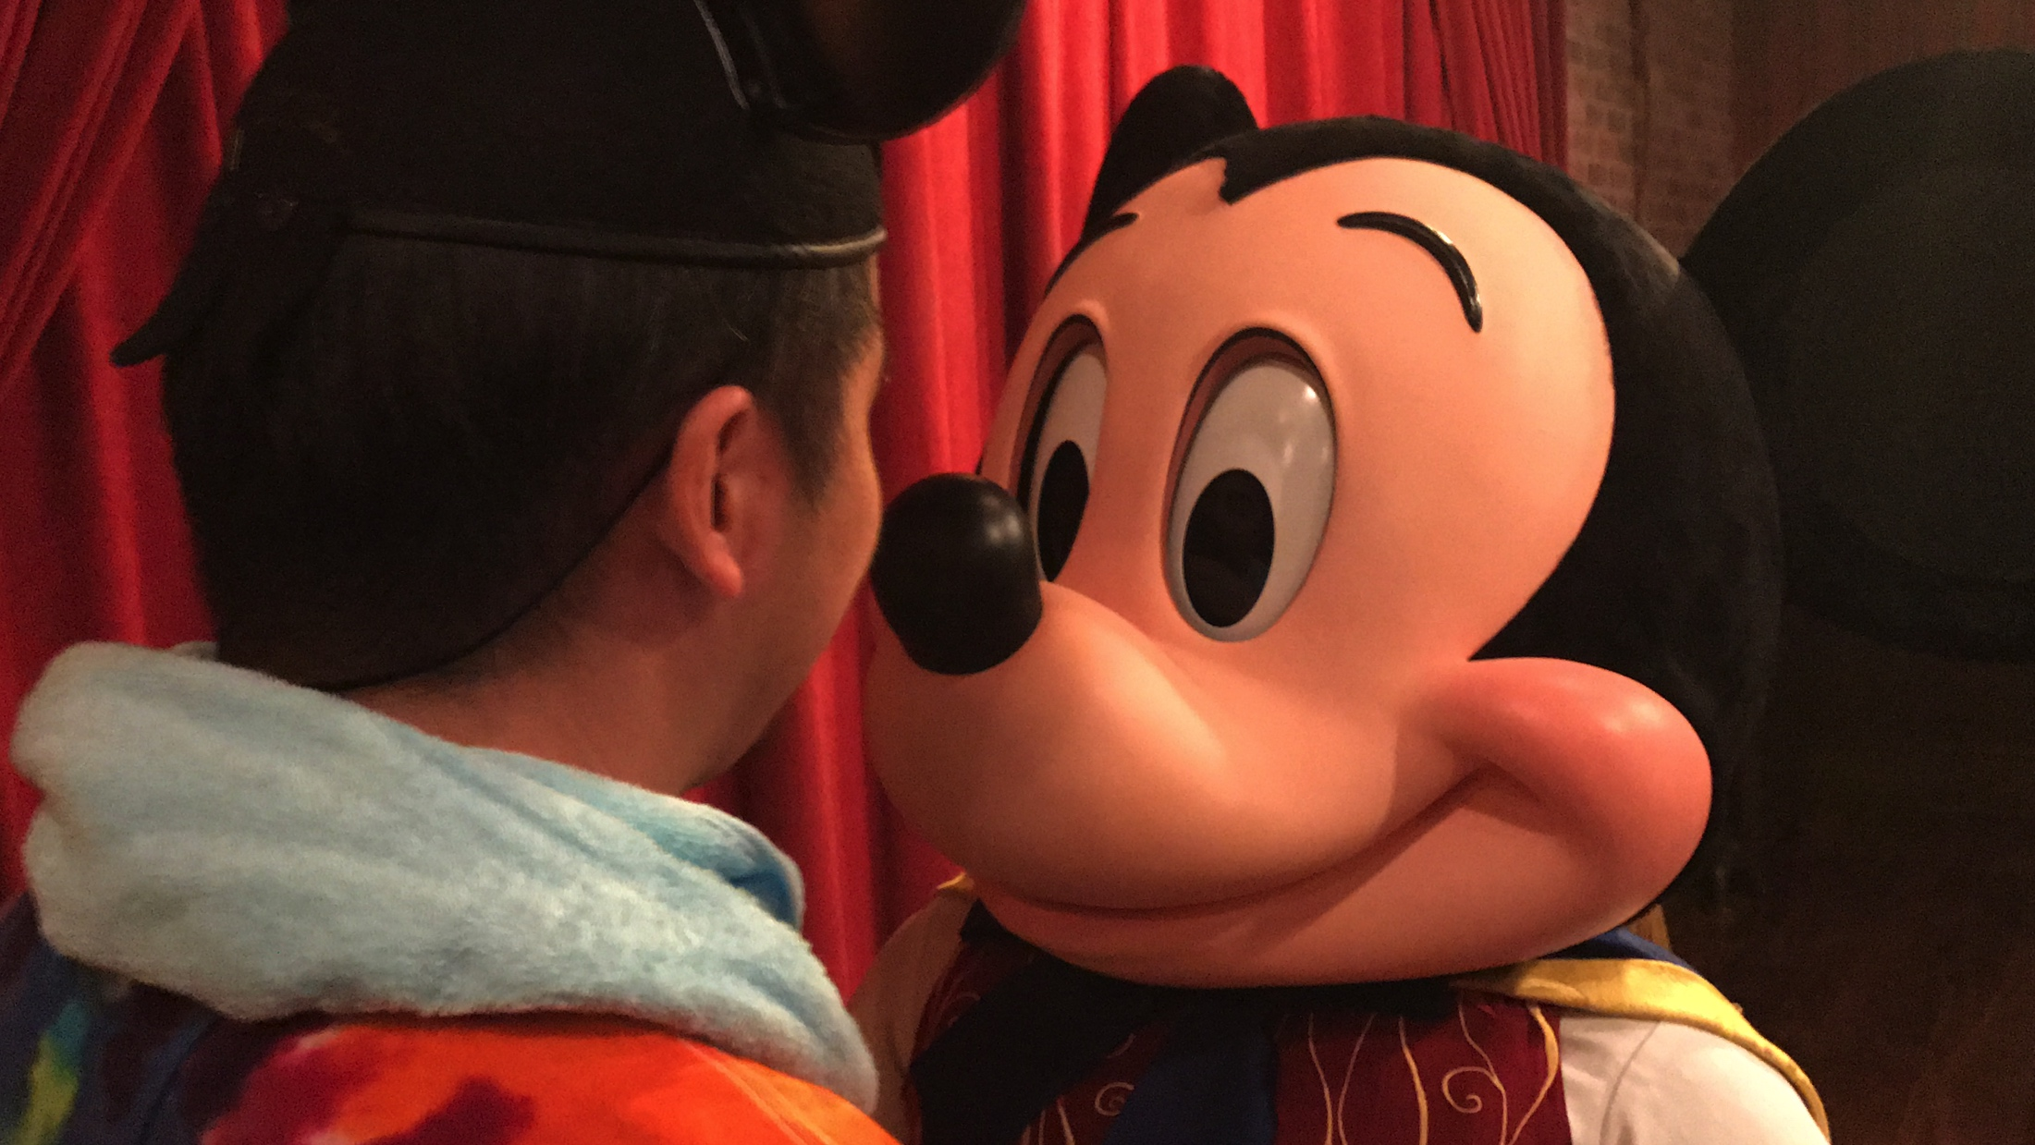
Day4 : Magic Kingdom
Cinderella Castle
Projection Mapping & Fireworks
Speaking Mickey

Slide 11
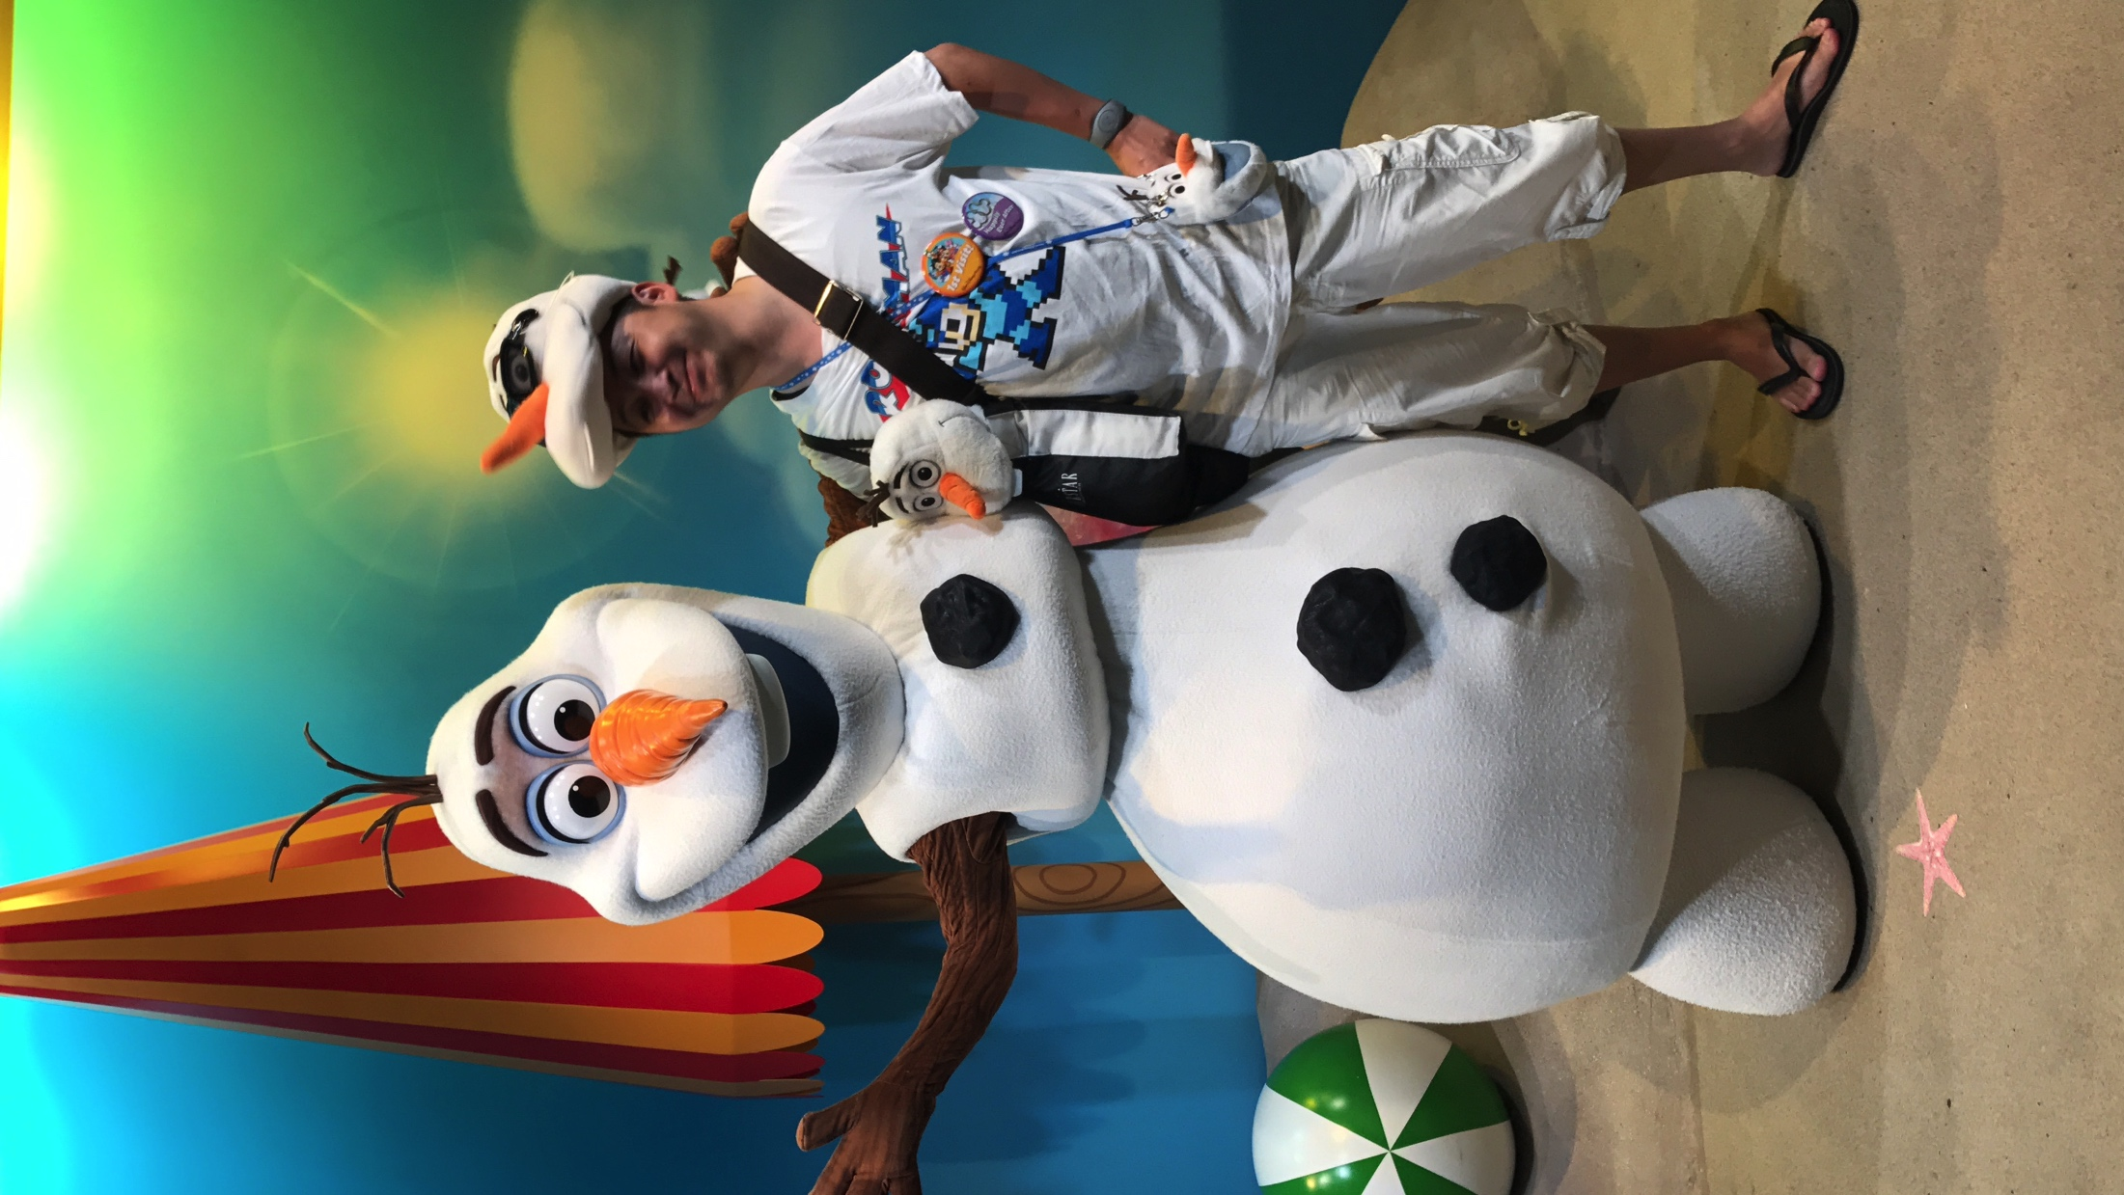
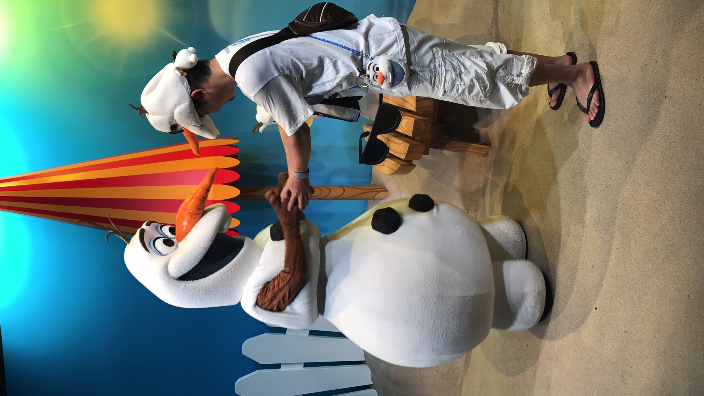
Day5 : Hollywood Studios
I respect you.
I met him at last and said …

Slide 12
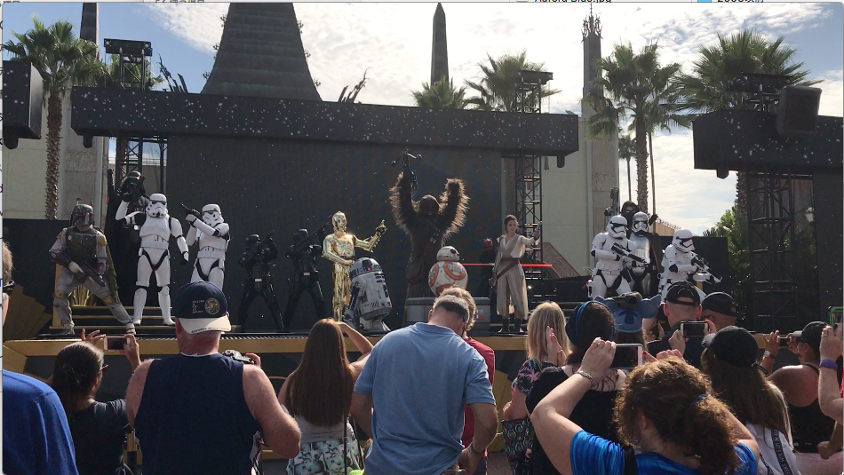
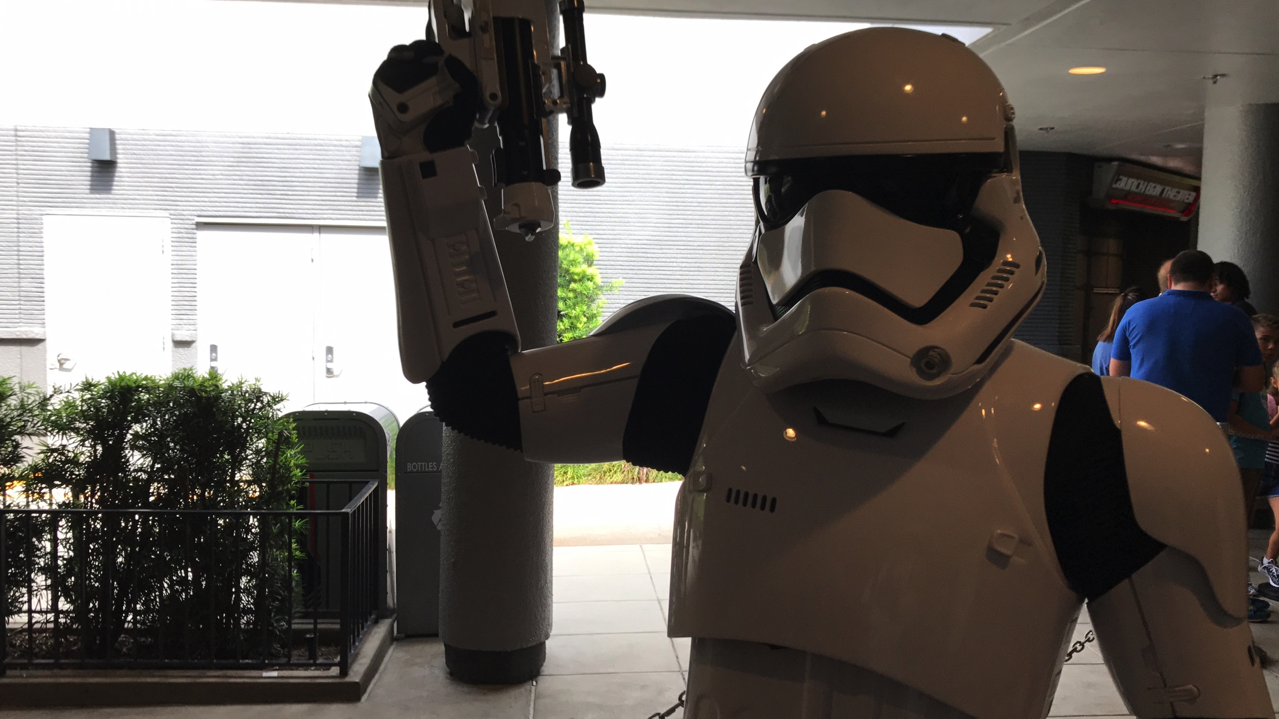
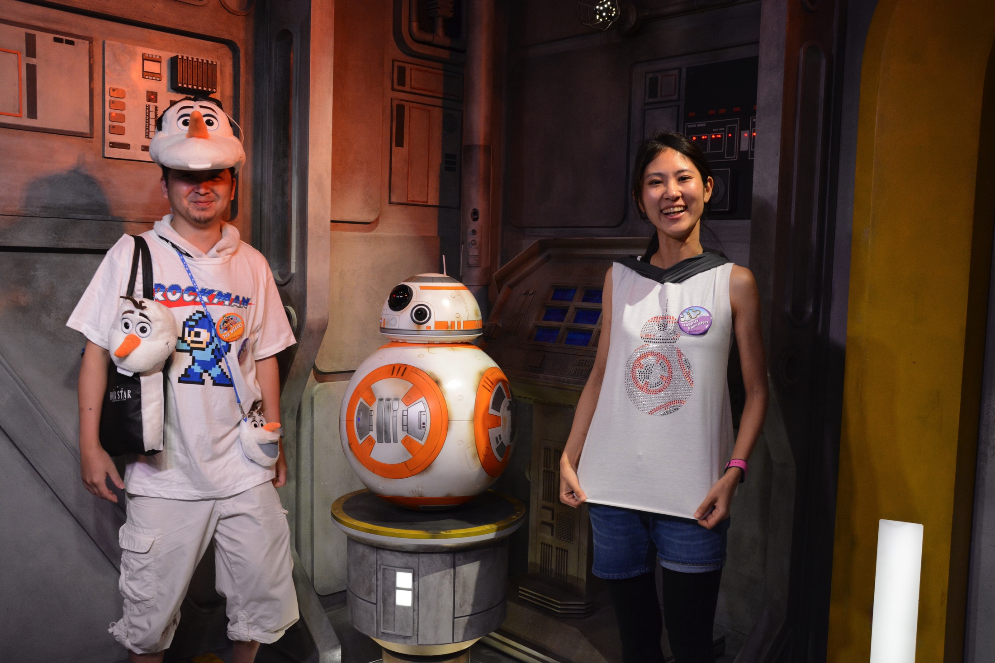
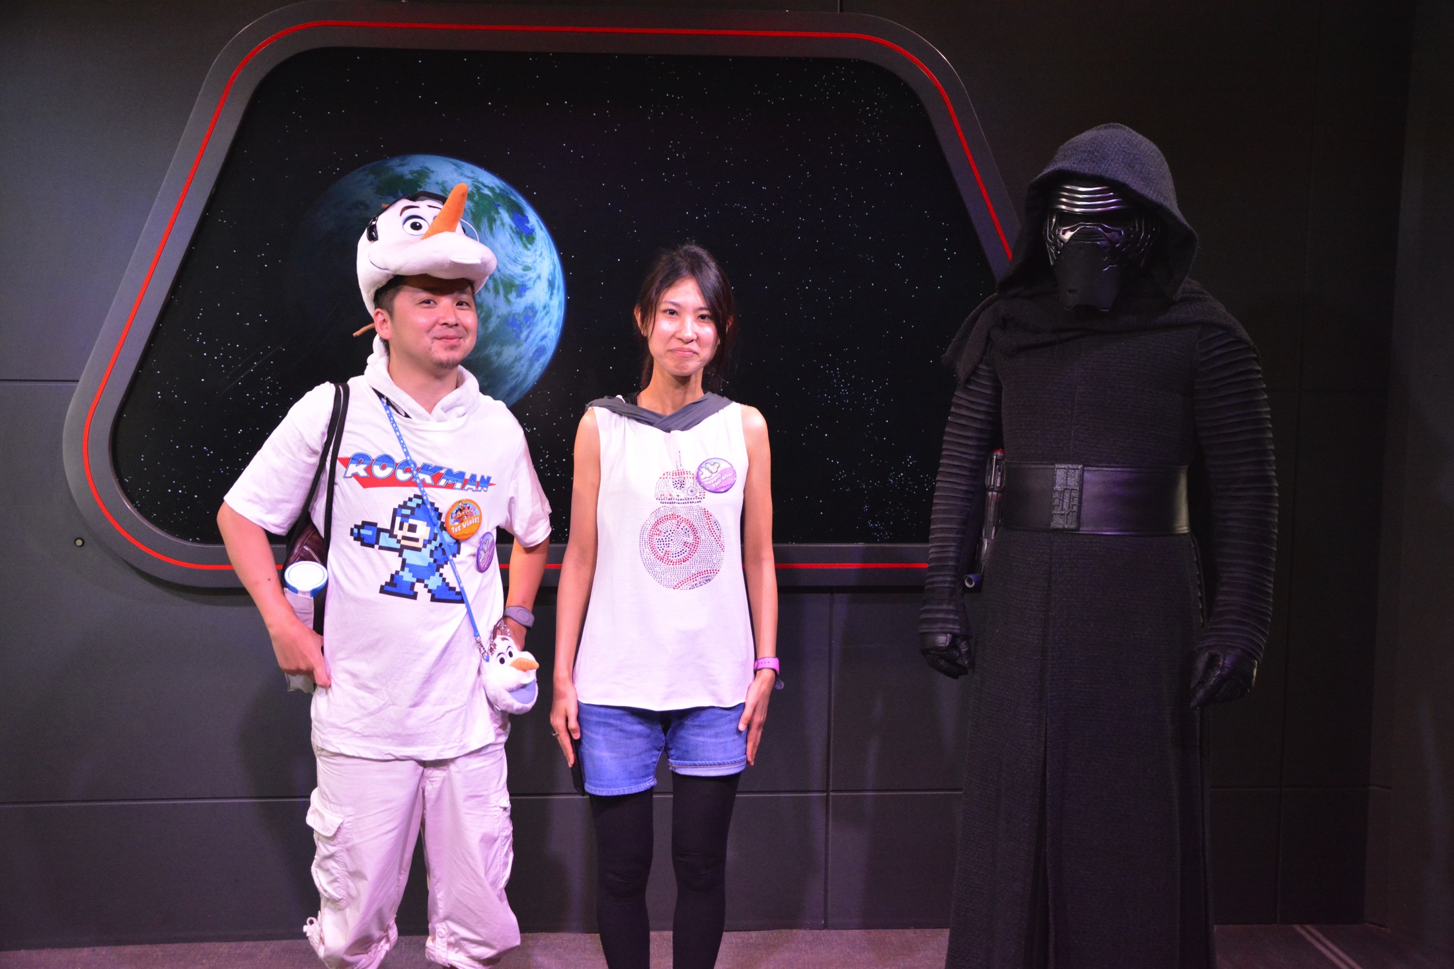
Day5 : Hollywood Studios

Slide 13
To be continued …

